Slide 1
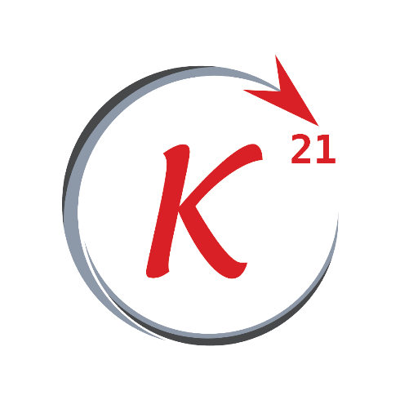
Machine Learning
Session 2

Slide 2
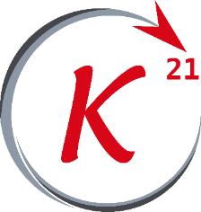
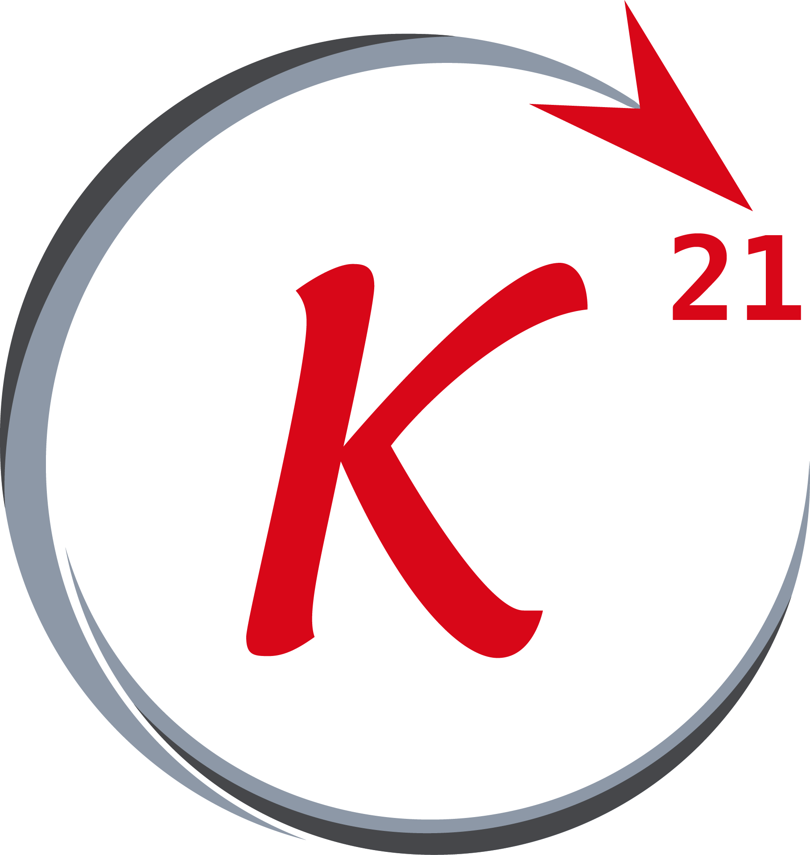


Session 2
Content
Linear regression with one variable review.
Cost function review.
Gradient descent.
Multivariate
Grow Through

Slide 3
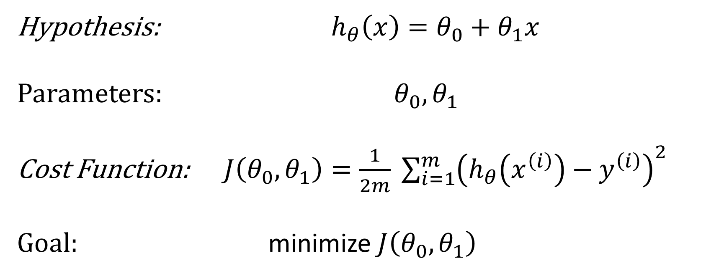
Linear Regression problem with one variable
Grow Through

Slide 4
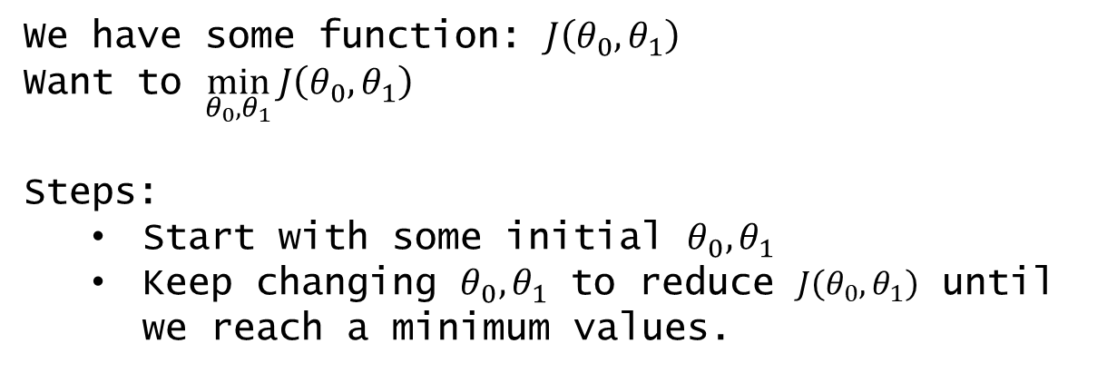
Session 2
Gradient descent
Gradient descent is a first-order iterative optimization algorithm for finding a local minimum of a differentiable function.
Grow Through

Slide 5

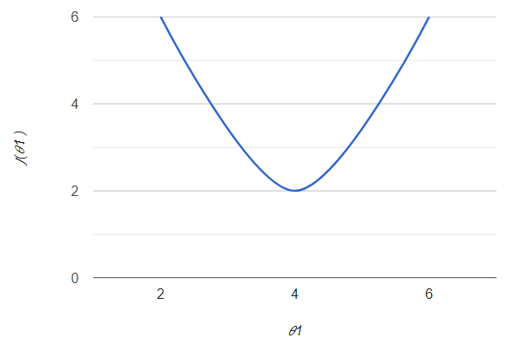
Session 2
Gradient descent
How to reach the local minimum ?
Negative slope
So the value of theta will keep increasing until it reaches the local minimum
Grow Through

Slide 6

Session 2
Gradient descent
How to reach the local minimum ?
Positive slope
So the value of theta will keep decreasing until it reaches the local minimum
Grow Through

Slide 7
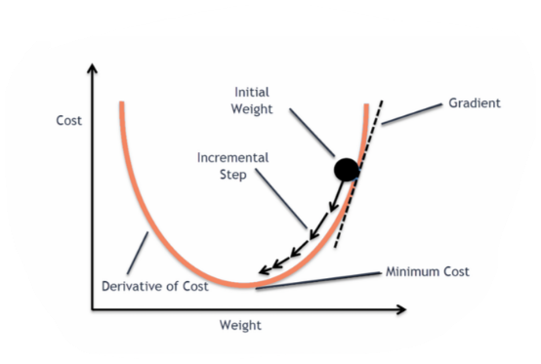
Session 2
Gradient descent
Grow Through

Slide 8
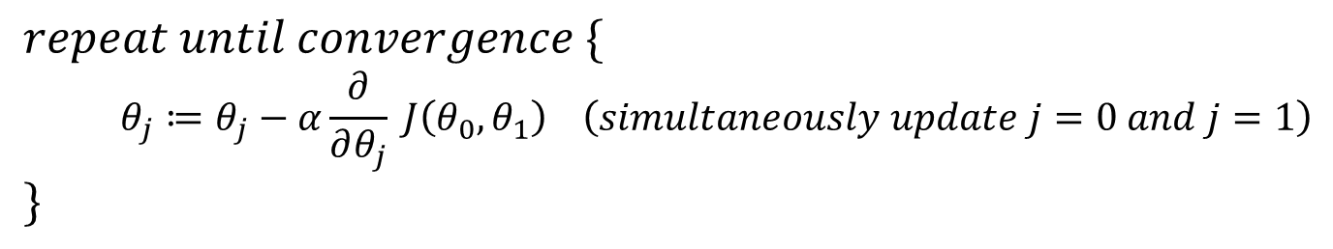
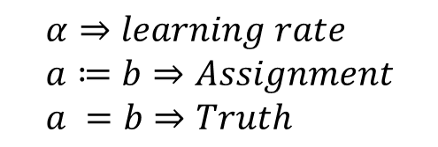
Session 2
Gradient descent algorithm
Grow Through

Slide 9
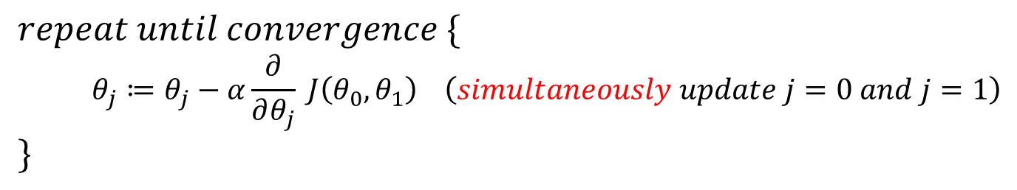
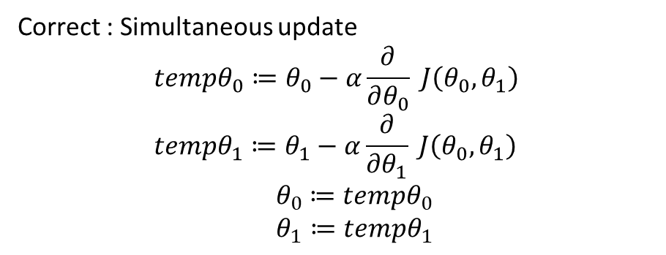
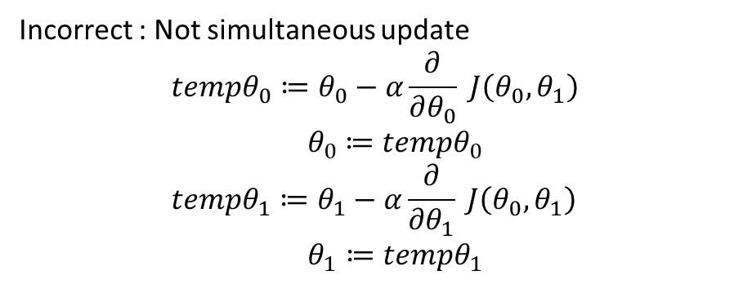
Session 2
Gradient descent algorithm
Grow Through

Slide 10

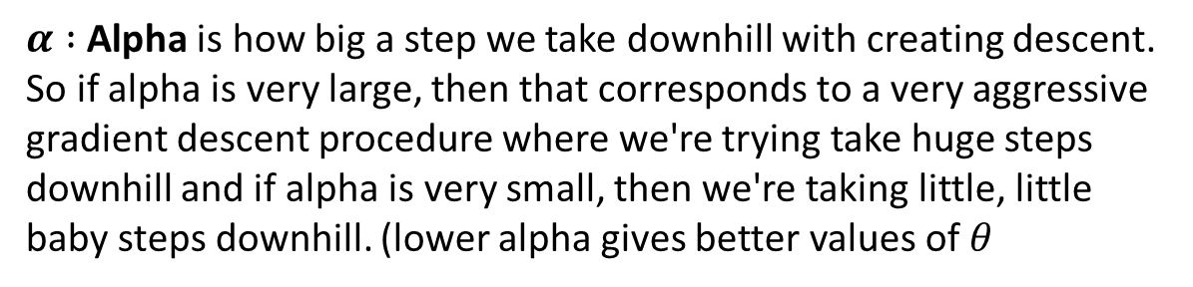
Session 2
Gradient descent algorithm
How to choose α
Grow Through

Slide 11

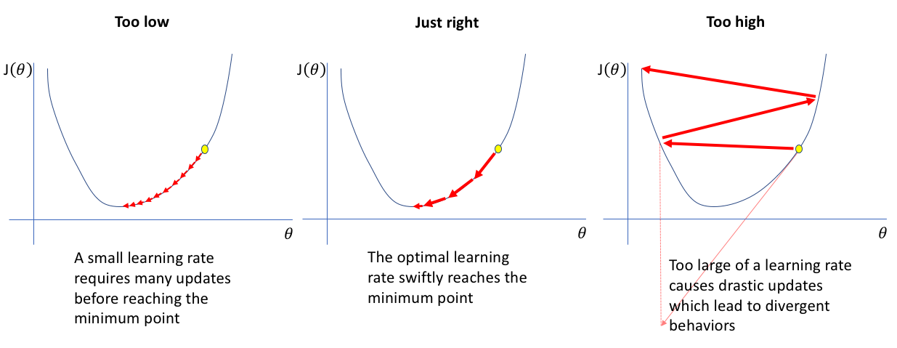
Session 2
Gradient descent
Grow Through

Slide 12
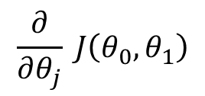
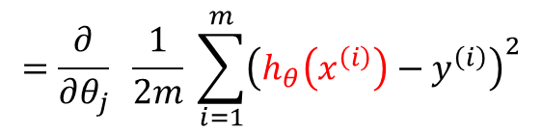
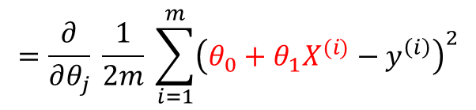
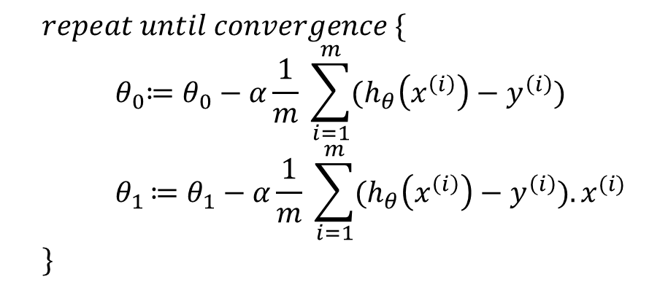
Session 2
Gradient descent equation
Grow Through

Slide 13
Session 2
Gradient descent
Grow Through

Slide 14
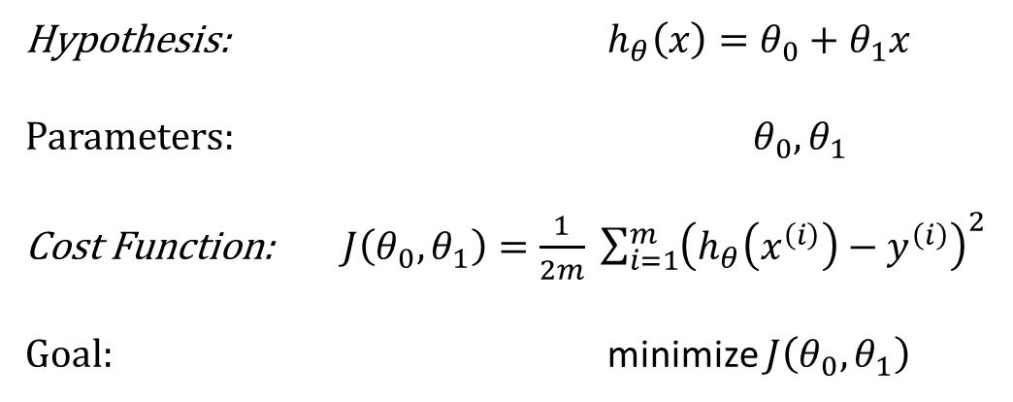
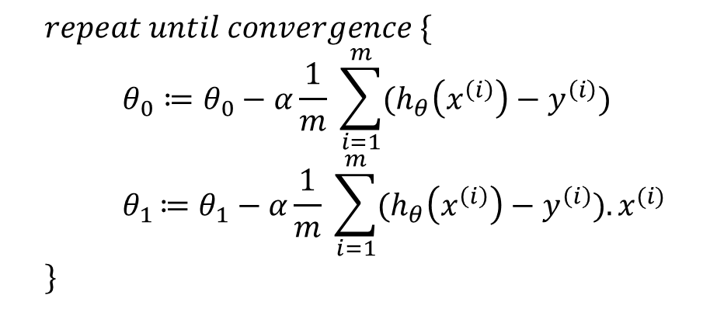
Session 2
All Equations:
Linear regression model
Gradient descent algorithm
Parameters: α
Grow Through

Slide 15
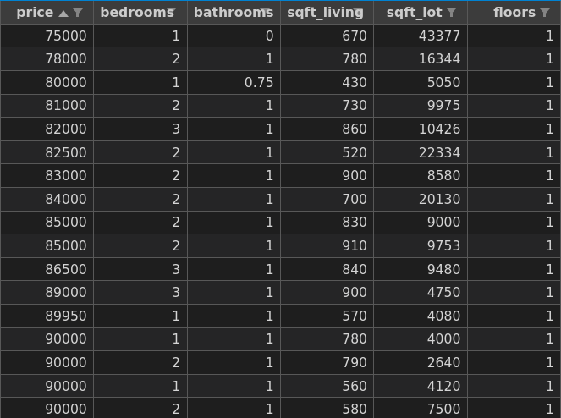
Multiple features
Variables
The data shown in the
figure has 5 features
each of which is a
variable used to find
the best fit line.
Grow Through

Slide 16
Multiple linear regression
Notation
Each row is denoted with the superscript (i) in x^{(i)}. e.g. x⁽³⁾ refers to the 3rd row in the data set
Grow Through

Slide 17
Multiple linear regression
Notation
Each feature is denoted with the subscript (i) in x_{(i)}. e.g. x₍₄₎ refers to the 4th feature in the data set.
Grow Through

Slide 18
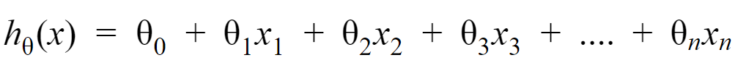


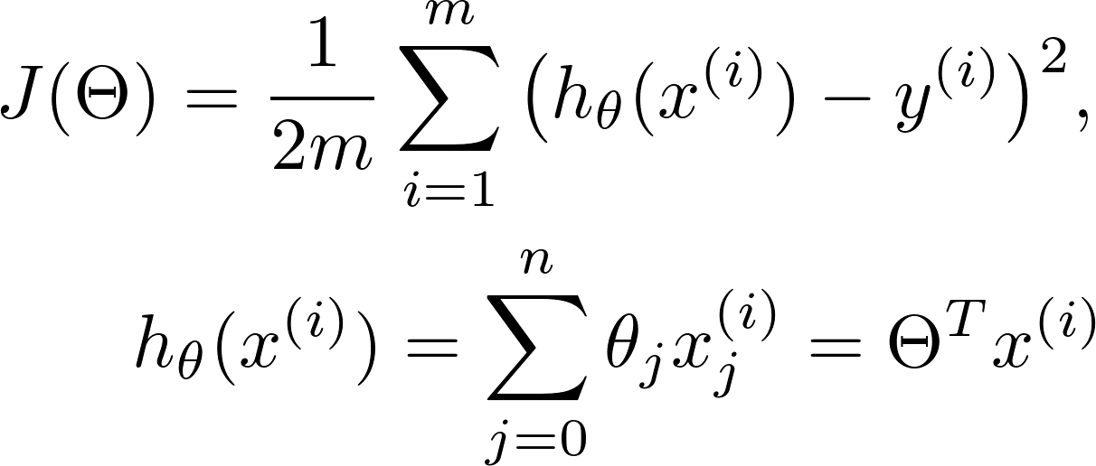
Multiple linear regression
Hypothesis function
The updated hypothesis when dealing with n different features.
Also another form of the equation is :
Where:
And x₀ = 1
Grow Through

Slide 19
Cost function
J
For a data set that has n different features and m training examples,
The cost function for it is:
Grow Through

Slide 20
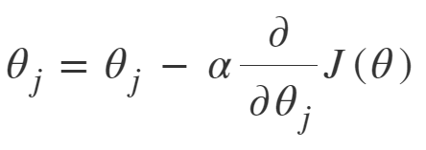


Gradient descent
Calculating theta
The equation for gradient descent is the same as before but with j being an integer in range(0,n).
Grow Through

Slide 21
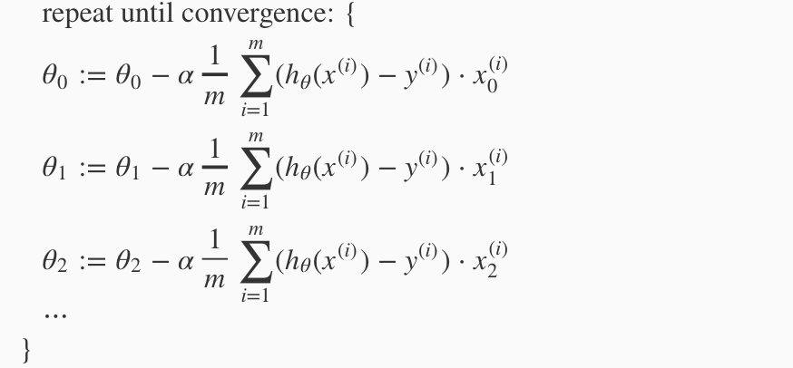
Gradient descent
Calculating theta
and so on
Grow Through

Slide 22
Bias
Bias basically means that the gradient descent tends to change the theta_{j} that corresponds to a high value X_{j} because it affects the cost function more than other parameters, causing the gradient descent to converge slowly or not being able to converge at all in most cases.
Grow Through

Slide 23
Bias
As an example, if a training set has a feature that ranges between (1000 - 50000) -maybe a car’s height in millimeters- and another that ranges between (0.1 – 2) -like a car’s engine’s volume in kilo cubic centimeters-, the gradient descent will try to tweak the 1st feature first although the output
-a car’s price- might be less dependent on it than the other feature, this might cause the gradient descent to take much longer time & path getting to the minimal J and in some cases might cause the path of the gradient descent to drift away from the conversion point.
Grow Through

Slide 24
Types of feature scaling
Types
3 types that we will discuss and use them apply feature scaling:
- Mean Normalization
- Standardization (Z Normalization)
- Unit Vector Normalization
Grow Through

Slide 25


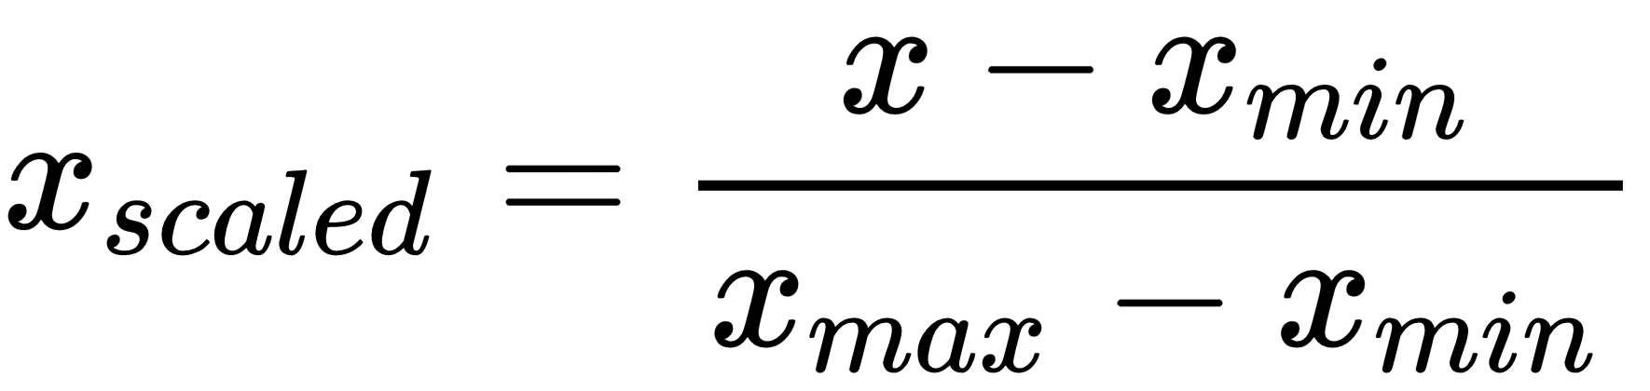
Types of feature scaling
Mean Normalization
Produces scaled features that is between (-0.5) and (0.5).
Grow Through

Slide 26
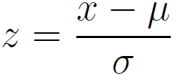
Types of feature scaling
Standardization
Standardization on a feature causes it to have mean of zero and a unit of variance.
Grow Through

Slide 27
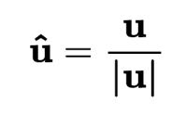
Types of feature scaling
Unit Vector Normalization
Scaling to unit length shrinks/stretches a vector (a row of data can be viewed as a D-dimensional vector) to a unit sphere.
*applies to a row of data set
Grow Through

Slide 28
Feature selection
Feature selection is a process where we choose the features which contributes the most in the output value and ignoring features that are irrelevant or with a tiny contribution, as having too many features that are irrelevant in our data set decreases the accuracy of the trained model.
Grow Through

Slide 29
Normal equation
Formula
Grow Through

Slide 30
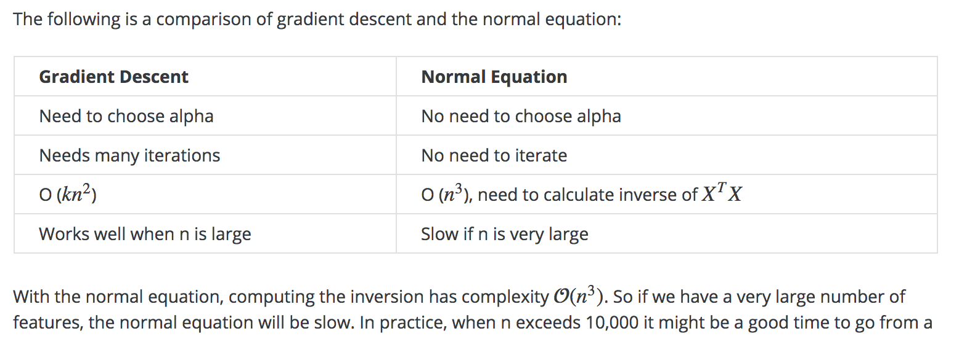
Normal equation
vs GD
Grow Through

